Slide 1

Species Distribution Modeling Background Info

Slide 2
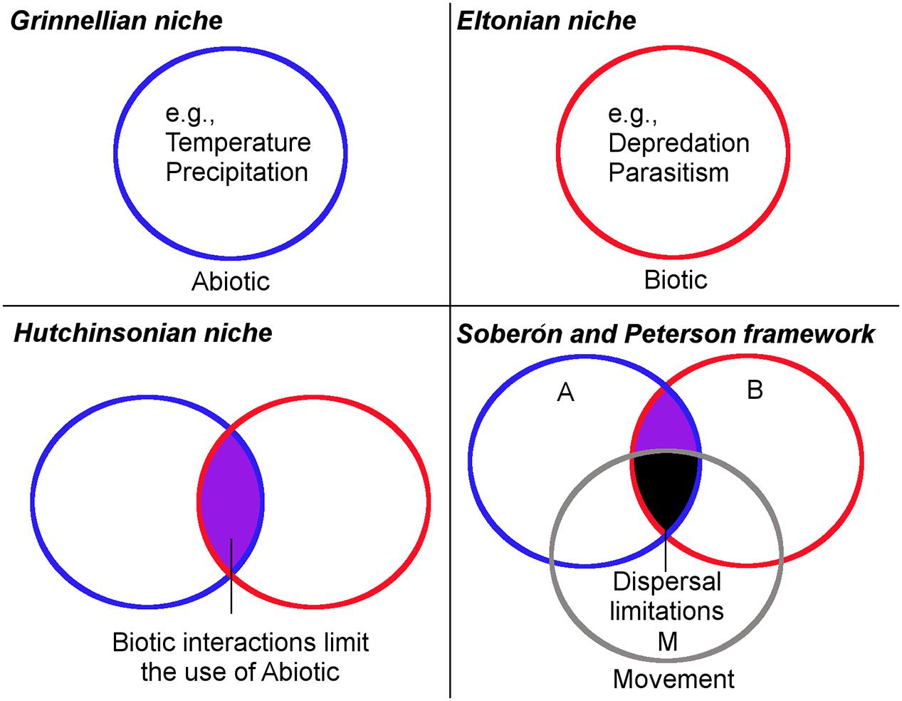
Biogeography Theory
Escobar & Craft, 2016

Slide 3
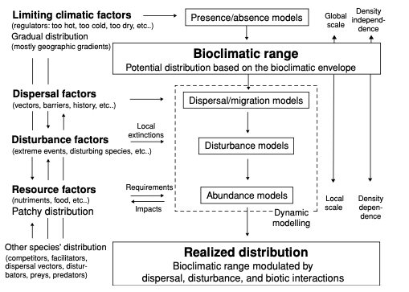
Biogeography Theory
Guisan & Thuiller, 2005

Slide 4
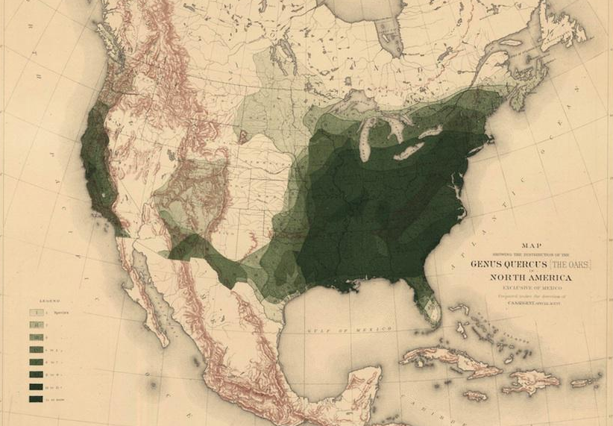
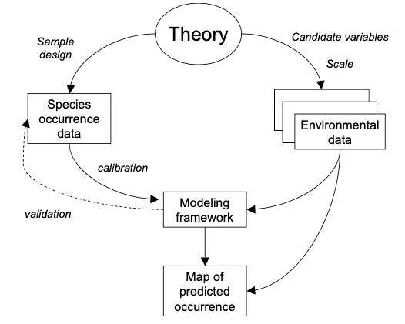
SDM (What)
C.S. Sargent, 1884

Slide 5
SDM (Why)
Know where organisms are
Insight into where organisms may be under changing conditions
Exploration of fundamental eco-evolutionary principles

Slide 6
SDM (How)
Correlative vs. Mechanistic
Franklin, 2010

Slide 7






Input Data (occurrences)

Slide 8




Input Data (Environment)

Slide 9
Algorithms
Profile methods
DOMAIN, BIOCLIM, Mahalanobis
Presence only data
Regression Methods
GLM, GAM, MARS
Presence and absence or background
Machine Learning Methods
MaxEnt, Random Forest, Support Vector Machines, GARP
Presence and absence or background

Slide 10
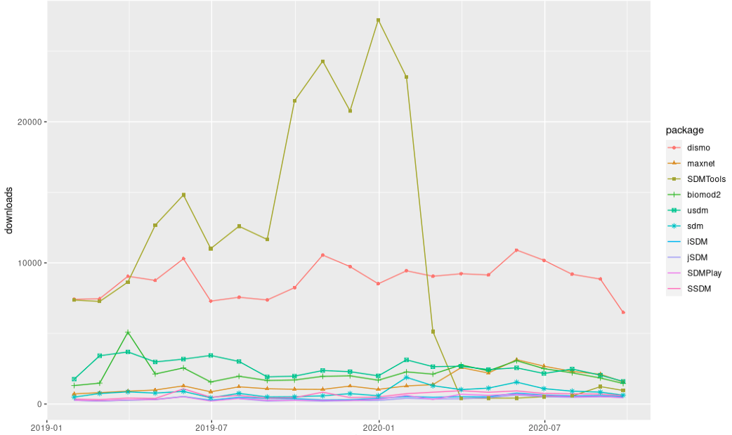

Slide 11
Algorithms
Profile methods
DOMAIN, BIOCLIM, Mahalanobis
Presence only data
Regression Methods
GLM, GAM, MARS
Presence and absence or background
Machine Learning Methods
MaxEnt, Random Forest, Support Vector Machines, GARP
Presence and absence or background

Slide 12
Algorithms
Profile methods
DOMAIN, BIOCLIM, Mahalanobis
Presence only data
Regression Methods
GLM, GAM, MARS
Presence and absence or background
Machine Learning Methods
MaxEnt, Random Forest, Support Vector Machines, GARP
Presence and absence or background
’dismo’

Slide 13
Algorithms
Profile methods
DOMAIN, BIOCLIM, Mahalanobis
Presence only data
Regression Methods
GLM, GAM, MARS
Presence and absence or background
Machine Learning Methods
MaxEnt, Random Forest, Support Vector Machines, GARP
Presence and absence or background
’dismo’
‘sdm’

